Slide 1
A Summative Evaluation on the Implementation of Self-Checkout Machines in the Philippines
Thomas and Friends
Notes:
(Introduction)
Slow Innovation in the Grocery Industry >> Since what they sell in grocery stores are essential to our lives, bla bla >> leads to our idea of innovation that changes the traditional checkout system which is the self-checkout shit (describe the self-checkout system)

Slide 2
Self-Checkout Machines in the Philippines
Why?
To Answer:
Advantages and Disadvantages
Effects
Is the Philippines ready?
Thomas and Friends
Notes:
Why (Rationale)
* Basahin rationale, kk?*
We wanted to test kung gagana sya sa Philippine Setting
Slowly introduce the research questions
What are the Advantages and Disadvantages of the System to the Philippines?
What would be the effects of the System to the
Owner
Economy o f the Philippines
Users
Is the Philippines ready for the implementation of Self-Checkout Systems?

Slide 3
Field Theory
Self-Checkout Machines
Popularity
Customer Satisfaction
User Interface
Line Queues
Unified Theory of Acceptance and Use of Technology
Customer Satisfaction Theory
Queuing Theory
Thomas and Friends
Notes:
*summarize the CF,
Self Checkout Machines Field Theory
- Interaction with another Field
Unified Theory of Acceptance and Use of Technology (UTAUT)
- Intentions of a user in using technology
Customer Satisfaction Theory
- Relationship between the customer/consumer and
Queuing Theory
- The mathematical study in waiting lines

Slide 4
Methodology
Research Design
Respondents
Instruments
Thomas and Friends
Notes:
Design - The design of the study is to know the outcome regarding the implantation of self-checkout system in the Philippines.
Respondents – Grocery store owners, customers, uhm, laborers(?) here in the Philippines.
Instruments – Idk which instruments you guys wanna use so

Slide 5
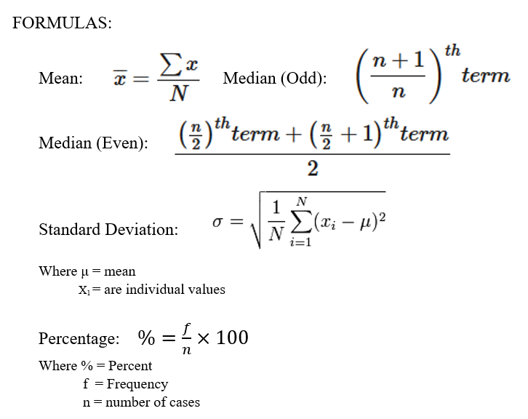
Thomas and Friends
Notes:
The gathered data will be processed by computing the mean, median, and mode in order to find out the standard deviation.
Mean – or Arithmetic Mean, is the average of all numbers
Median – or Statistical Median, the middle number
Mode – The most frequent value / occurs the most
Standard Deviation – how the data is spread out from the average (high SD – much more spread out)
Use of Pie chart to indicate the percentage of gathered data

